Slide 1

Semester Project - III
“PulseWallet”
Personal Financial Planning & Fraud Detection System
By
1. Devansh Chaudhary- 241106029
2. Sakshi Shimpi-241106103
3. Shubham Wagh-241106113
4. Utkarsh Mahajan-241106115
Under the Guidance of
Dr. P. K. Patil
Department of Computer Science & Engineering (Data Science)
The Shirpur Education Society’s
R. C. Patel Institute of Technology, Shirpur - 425405.
[2026-27]

Slide 2
Outline
Problem Statement
Objectives
Literature Survey
Proposed Solution & System Architecture
Dataset (Fraud Detection Model)
Technical Approach & Methodology
Tools and Technologies
Expected Results
Limitations
Conclusion
References

Slide 3
PulseWallet
Problem Statement
People manage income, expenses, budgets and savings goals across scattered apps and spreadsheets, with no single view of their finances — and transaction fraud is usually discovered only after money is lost.
What: No unified platform combines financial planning with real-time fraud protection.
Who: Everyday users managing bank accounts, UPI and cards across multiple apps.
Why: Delayed fraud detection and fragmented planning tools cause financial loss and poor money habits.
How: PulseWallet integrates a financial-planning engine with an XGBoost-based fraud detection service to flag risky transactions in real time and guide financial decisions.

Slide 4
PulseWallet
Objectives
Build a secure Spring Boot + PostgreSQL backend with JWT authentication for user-specific financial data.
Deliver a financial-planning engine that produces budgets, spending forecasts, and savings/investment recommendations.
Design and integrate an XGBoost-based fraud detection microservice that scores every transaction and raises real-time alerts.
Enable goal-based savings planning, credit-card intelligence and a purchase advisor.
Validate the system through backend/frontend testing and ship a redesigned frontend dashboard.

Slide 5
Literature Survey
Consumer apps such as Mint and YNAB focus on manual budgeting and spend tracking, with little predictive planning.
Fraud checks in most banking systems are static, rule-based thresholds rather than adaptive ML models.
Financial planning and fraud protection are usually offered as separate, disconnected tools.
PulseWallet differs by combining planning, goal/credit intelligence and an XGBoost fraud-detection service that feeds real-time alerts directly into the same platform.

Slide 6
Proposed Solution — System Architecture
PulseWallet pairs a Spring Boot backend with a FastAPI + XGBoost fraud-detection microservice for real-time alerts.
PULSEWALLET
React Frontend
FastAPI
XGBoost Model
Spring Boot
REST APIs
Business Logic
Security
Spring Data JPA
PostgreSQL

Slide 7
Dataset (Fraud Detection Model)
Source: a public credit-card transaction fraud dataset used to train and evaluate the fraud-detection model.
Size & features: anonymized transaction records with amount, time and numerical features, strongly imbalanced (fraud is a small minority of transactions).
Preprocessing: feature scaling/normalization, class-imbalance handling, and a train/test split.
EDA & model selection: Random Forest and XGBoost were both trained and compared; XGBoost was selected as the production model for its precision/recall trade-off on imbalanced data.

Slide 8
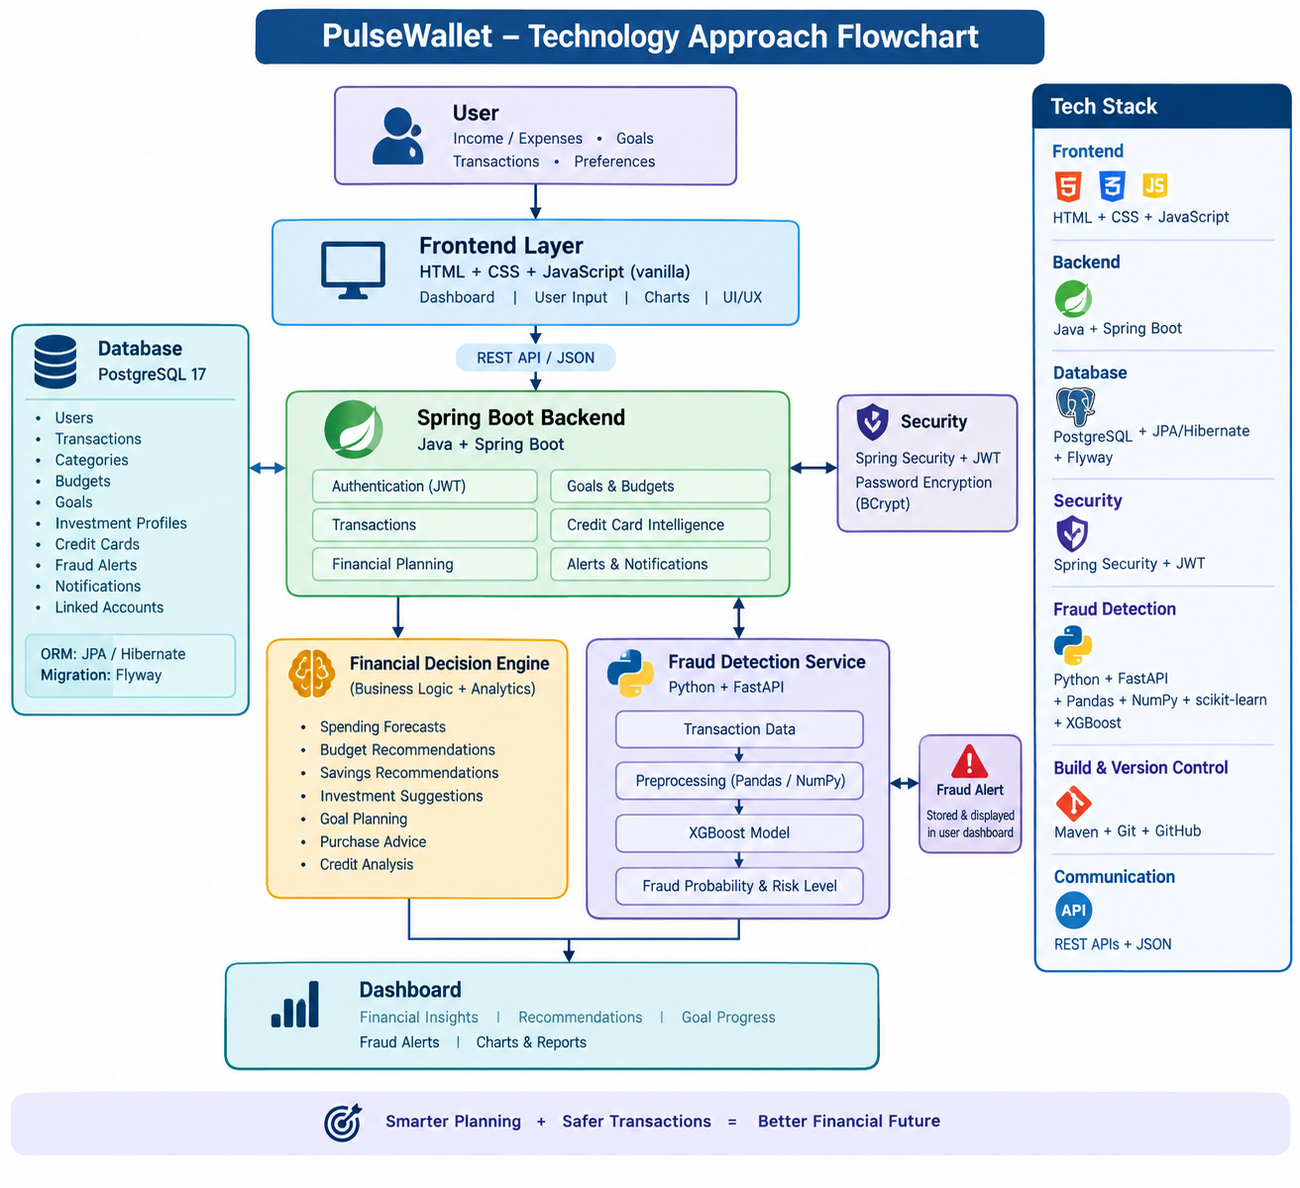
Technical Approach
Fraud detection pipeline (see flow below): each transaction is scored by the trained model and converted into a risk level that can trigger an alert.
Algorithms evaluated: Random Forest and XGBoost.
Selected model: XGBoost — chosen for stronger performance on the imbalanced fraud dataset and fast inference inside the FastAPI service.
Transaction
Risk Score /
Level

Slide 9
Technical Approach
Tools and Technologies
Backend
Java, Spring Boot 4.1, Spring Security + JWT, Maven, Git/GitHub
Database
PostgreSQL 17, Spring Data JPA / Hibernate, Flyway migrations (V1–V13)
Fraud ML
Python, XGBoost + scikit-learn, Pandas / NumPy, served via FastAPI (/fraud-check)
Frontend
React + JavaScript/JSX with Vite, Chart.js for financial visualizations
Integration
REST + JSON linking the React frontend, Spring Boot backend, and FastAPI fraud service

Slide 10
Expected Results
Real-time fraud alerts when a transaction's risk score crosses a configurable threshold.
Personalized financial planning: budget recommendations, spending forecasts, and savings/investment suggestions.
Goal tracking with automatic monthly-saving calculations, plus credit-card utilization insights and purchase-advisor recommendations.
Verified through testing: 149 backend tests passing (0 failures, 0 errors) and a successful frontend build.

Slide 11
Limitations
Linked Payment Accounts is currently a connection-management foundation, not a live PhonePe/Google Pay/bank login integration.
The fraud model is trained on a public dataset, so real-world transaction patterns may differ and periodic retraining is needed.
Class imbalance in fraud data can reduce recall on rare fraud patterns not well represented in training.
The frontend (currently React) is being redesigned into plain HTML/CSS/vanilla JavaScript, so UI/UX polish is in progress.

Slide 12
Conclusion
PulseWallet is a personal financial planning and transaction fraud detection system. The backend (Java Spring Boot + PostgreSQL) provides secure authentication and transaction management, with a financial-planning engine for budgeting, forecasting, savings and goal-based recommendations.
A separate FastAPI + XGBoost machine-learning service performs fraud detection and is integrated with the backend to raise real-time alerts. On top of this, PulseWallet adds credit-card intelligence, a purchase advisor, and linked payment-account management, all surfaced through a React frontend dashboard.
Status: all major modules through Linked Payment Accounts are implemented and verified (149 backend tests passing); the frontend is now being redesigned.

Slide 13
References
Finexa — IEEE, 2026: personal finance, goal-based planning and budgeting, informing PulseWallet's financial-planning engine.
A Comprehensive Review of ML Techniques for Intelligent Personal Finance Management Systems — 2026: research gap and integration approach for combining planning with ML-based intelligence.
XGBoost + SMOTE for Credit Card Fraud Detection — IEEE, 2024: basis for our fraud-detection methodology, including class-imbalance handling.
XGBoost with Bayesian Optimization for Fraud Detection — 2025: recent XGBoost fraud-detection research informing model tuning and evaluation.

Slide 14
Things you have to bring in folder
Folder Name — Group No.03_PulseWallet
Reference papers
Dataset (fraud-detection dataset, along with download link)
PPT
Single Word copy containing:
✓ Abstract soft copy (hard copy already submitted)
✓ Project objectives
✓ Methodology diagram

